Slide 1
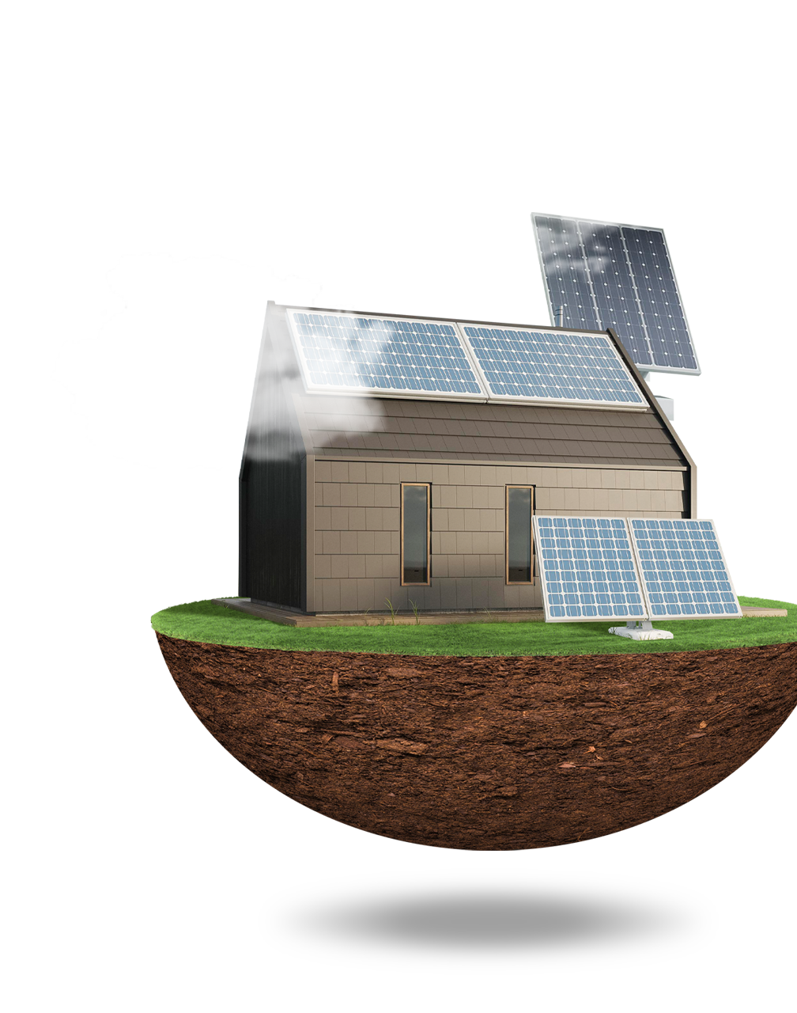
SOLAR PANELS POWER OUTPUT PREDICTION
-Likhit Chilamakuru
- 002702326

Slide 2
TABLE OF CONTENTS
01
02
03
04
05
06
Dataset
Data Analysis
Model
Feature Selection
Testing
Evaluation

Slide 3
Horizontal Photovoltaic Power Output Data
12 Locations
16 Features
Target Feature
Contains power output from photovoltaic panels located at 12 Northern hemisphere sites over 14 months
location, date, time sampled, latitude, longitude, altitude, year and month,season, humidity, ambient temperature, wind speed, visibility, pressure, and cloud ceiling
Power output from the solar panel

Slide 4
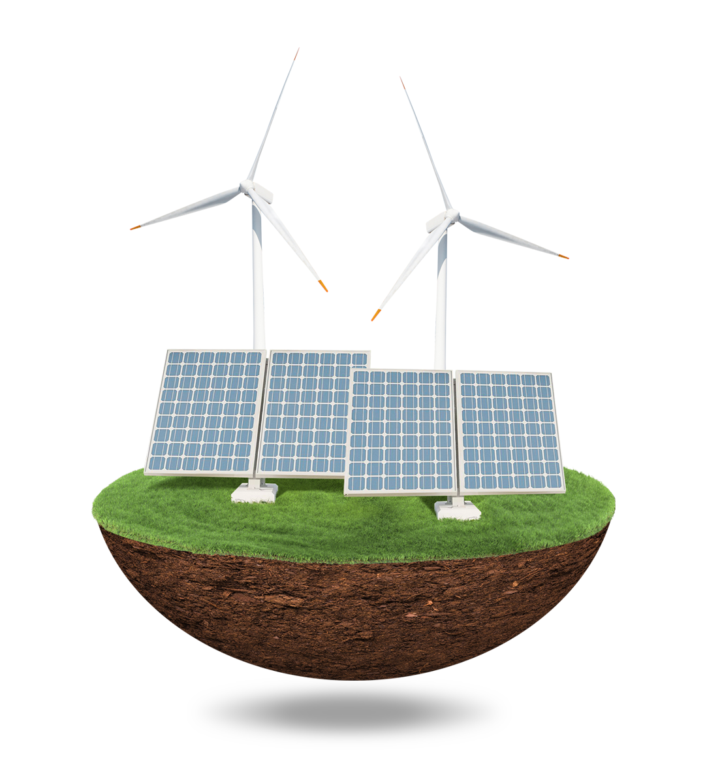
ABOUT THE PROJECT
Problem to be solved: Investigate ways to predict how much power a solar panel will generate without using information about how much sunlight it is receiving (Irradiance). This could help us save time, money, and resources while still achieving accurate results.

Slide 5
STEPS
Data Analysis
Feature Selection
Build Model
Performing Data Analysis on features.
Selecting important features i.e Feature Extraction.
On the features obtained, build model
HyperParameters
Testing
Evaluation
Tune the hyper parameters to fit the model.
Test the model on testing data.
Evaluate the model using performance metrics.

Slide 6
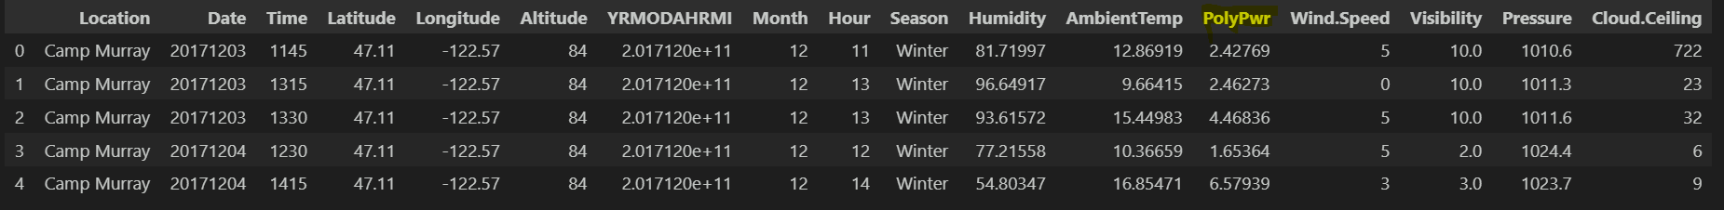
DATASET SAMPLE

Slide 7
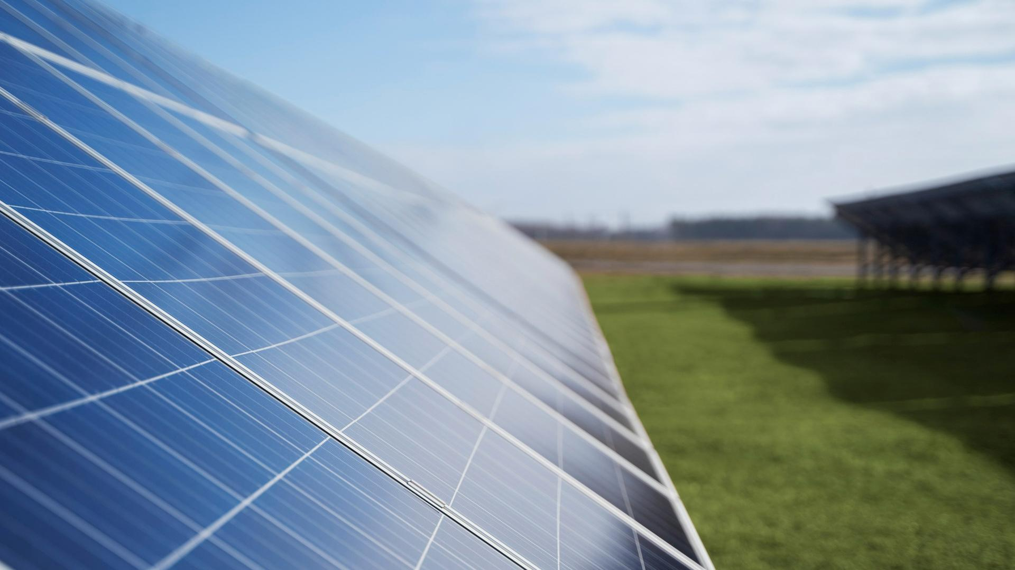
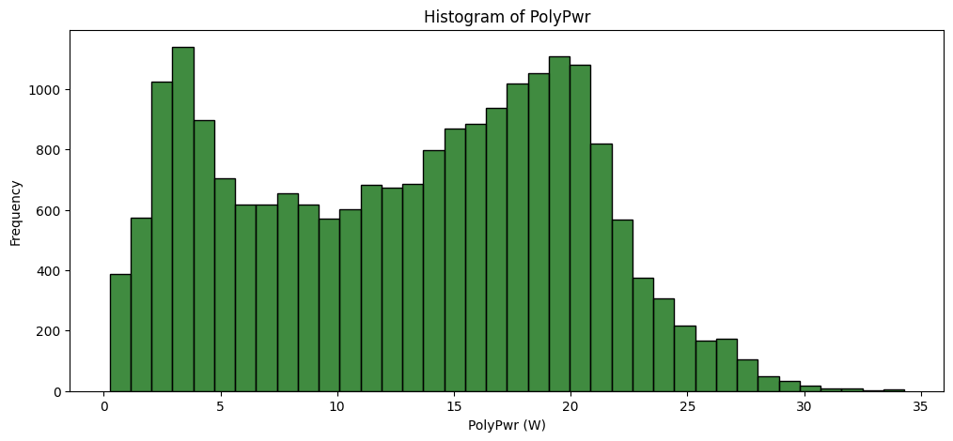
Data Analysis
Histogram of Power Output

Slide 8
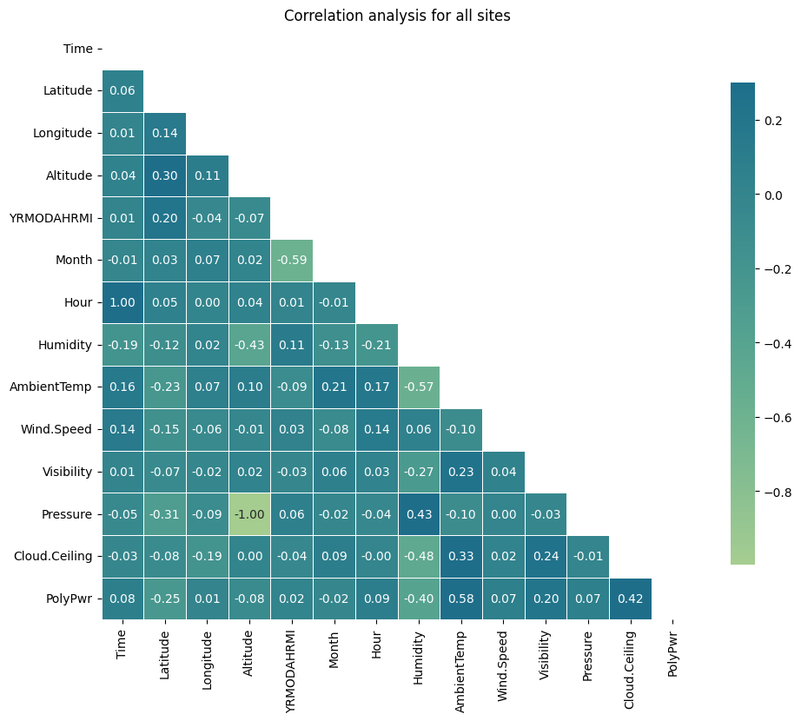
Data Analysis
Correlation of Features
Altitude and pressure are perfectly correlated, but altitude does not change. We need not use Altitude.
Ambient temperature, humidity and power have high correlation

Slide 9
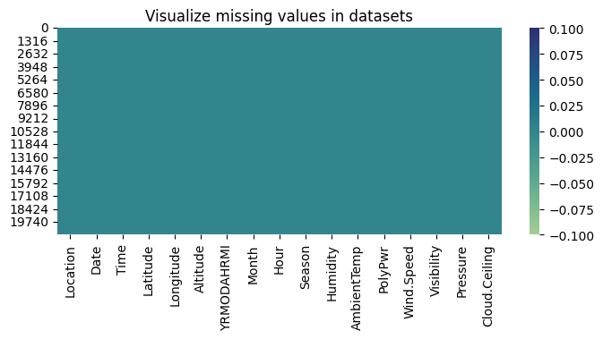
DATA ANALYSIS
Visualization of Missing Values

Slide 10
FEATURE SELECTION
1. Altitude is dropped because it has a high correlation with Pressure but does not change for a given location while pressure is more dynamic.
2. Longitude is dropped because it has zero correlation with the target variable.
3. Time, Hour, Month and Date are dropped because they have strong correlations with the engineered cyclic features but low correlation with the target variable.

Slide 11
MODEL - KNN WHY?
To capture complex nonlinear relationships between the input features and the target variable, without making any assumptions about the underlying data distribution.
To Find the k-nearest training examples to a given test example in feature space, and then predicting the target variable based on the average (or weighted average) of the target values of the k-nearest neighbors.
KNN is a non-parametric algorithm, which means that it does not require assumptions about the underlying data distribution, and it can capture arbitrary nonlinear relationships between the input features and the target variable.

Slide 12
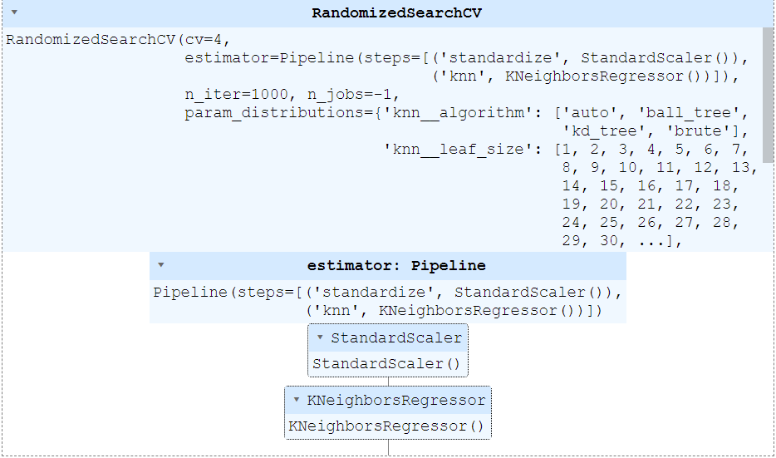
Model

Slide 13
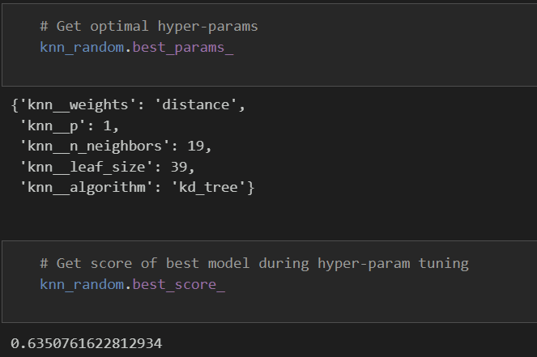
TEST and ACCURACY

Slide 14
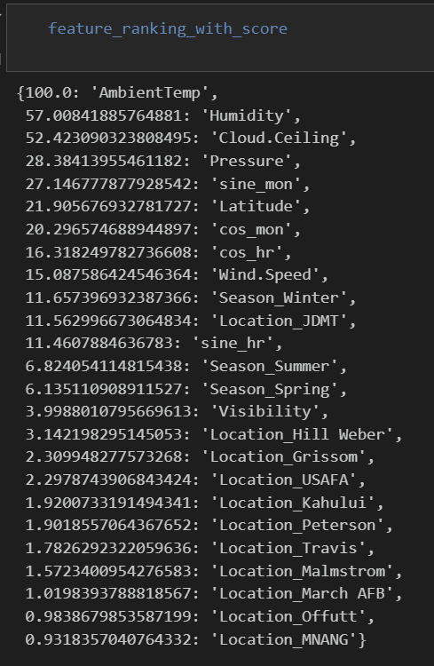
BEST FEATURES

Slide 15
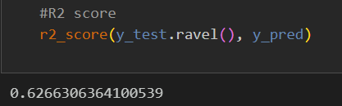
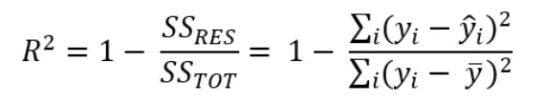
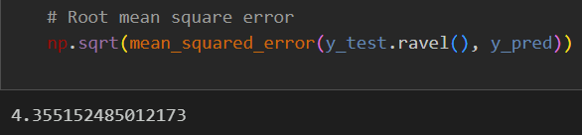
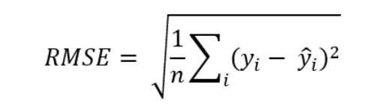
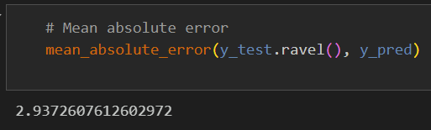
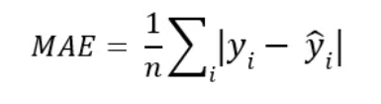
EVALUATION

Slide 16
EVALUATION

Slide 17
Thank You

